Slide 1

Property Analytics
#DATAWITHDAN
The predictive power of regression on condominium prices
By: Daniel Chang

Slide 2

The Dilemma Faced By Many..
Some may want to find an ideal home, while others look to make a profit out of it.
Unsure which condominium is worth value for money
The real estate market has one of the most opaque information systems, hence affecting decision making
This Photo by Unknown Author is licensed under CC BY

Slide 3
Why It Matters
The real estate market has one of the most opaque information systems.
Homogenous commodities ( e.g. Stocks) V.S. Diverse Commodities (e.g. Real Estate)
Price discovery mechanism in real estate markets is not efficient
Public available information is not very effective when it comes to decision making.

Slide 4

The Objective
To bridge the gap for buyers in buying their ideal homes
Enable property investors and real estate developers to maximise their Returns On Investments (ROI)
Identifying factors that drive the condo prices
This Photo by Unknown Author is licensed under CC BY

Slide 5
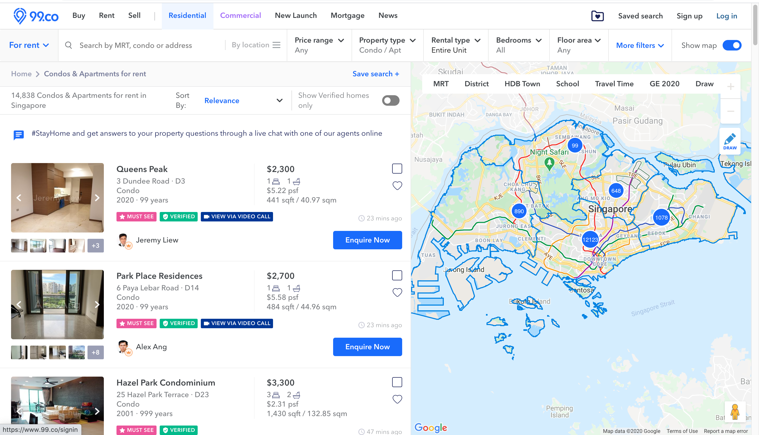
Datasets gathered from..

Slide 6






Packages used
Web Scrapping
Data Preparation
Regression
Data Visualization

Slide 7
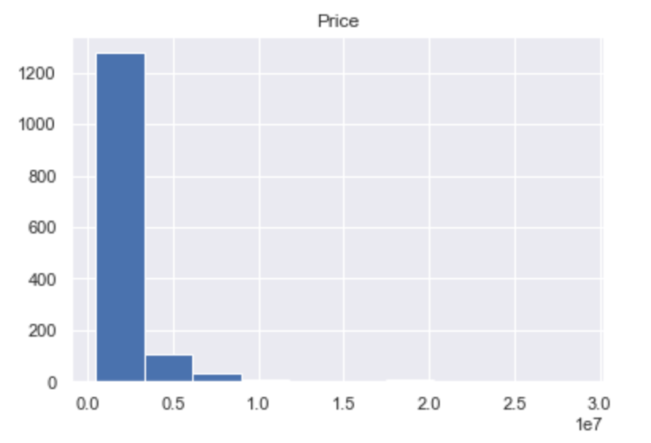
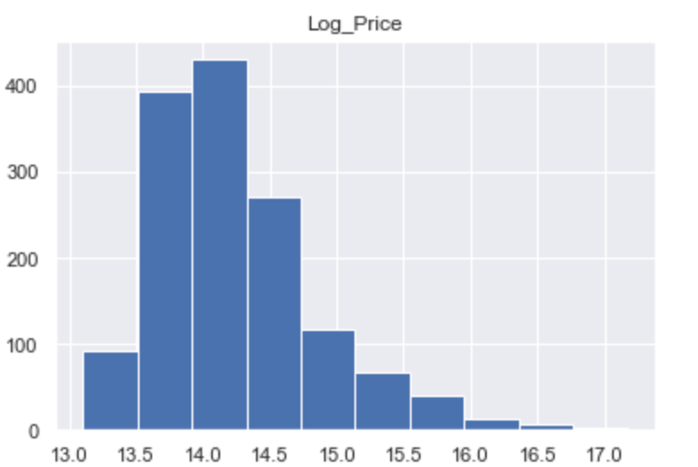
Target Variable: Log_Price
Log the target variable to get a more normal distribution.

Slide 8
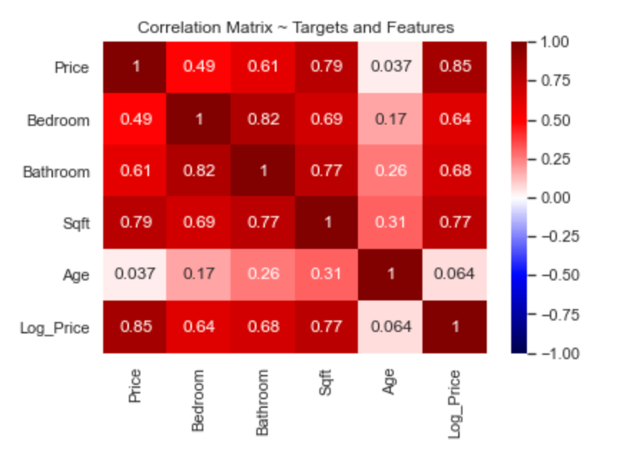
Correlation Matrix
Bathroom is found to be highly correlated with Bedroom and Sqft, hence we drop it to reduce multicollinearity.

Slide 9
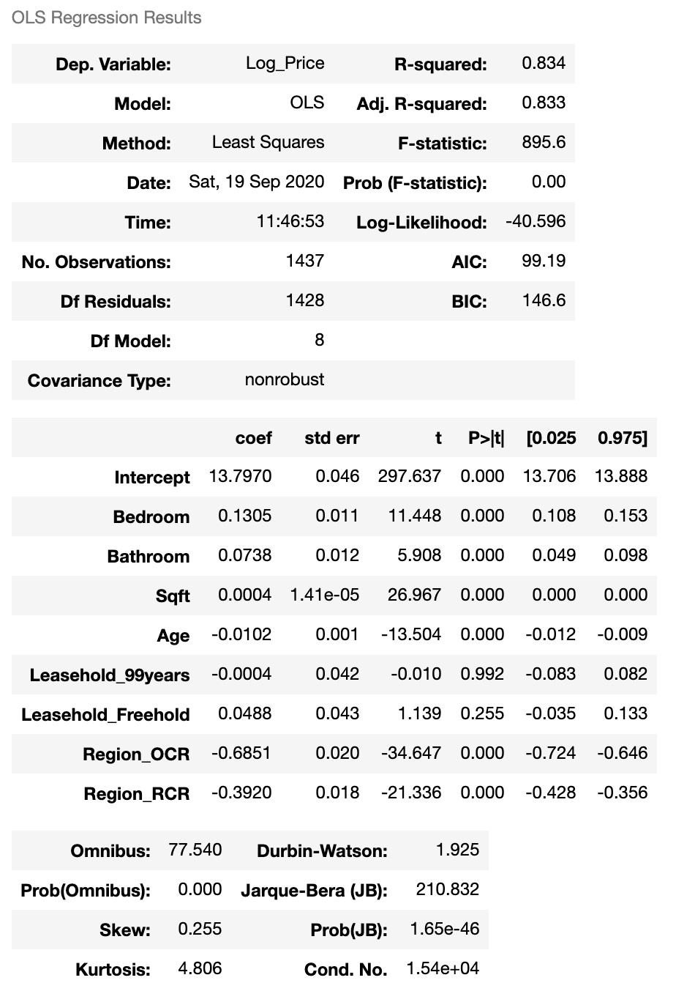
Linear Regression: Statsmodels
Dependent Variable ➔ Log_Price
Created dummy variables from Leasehold and Region
Baseline ➔ Condos of 999 years lease in Core Central Region (CCR)
Drop Features that has high p-values
Leasehold_99years
Leasehold_Freehold
*For definition on region classification please refer to this website from Redbrick Mortgage Advisory

Slide 10
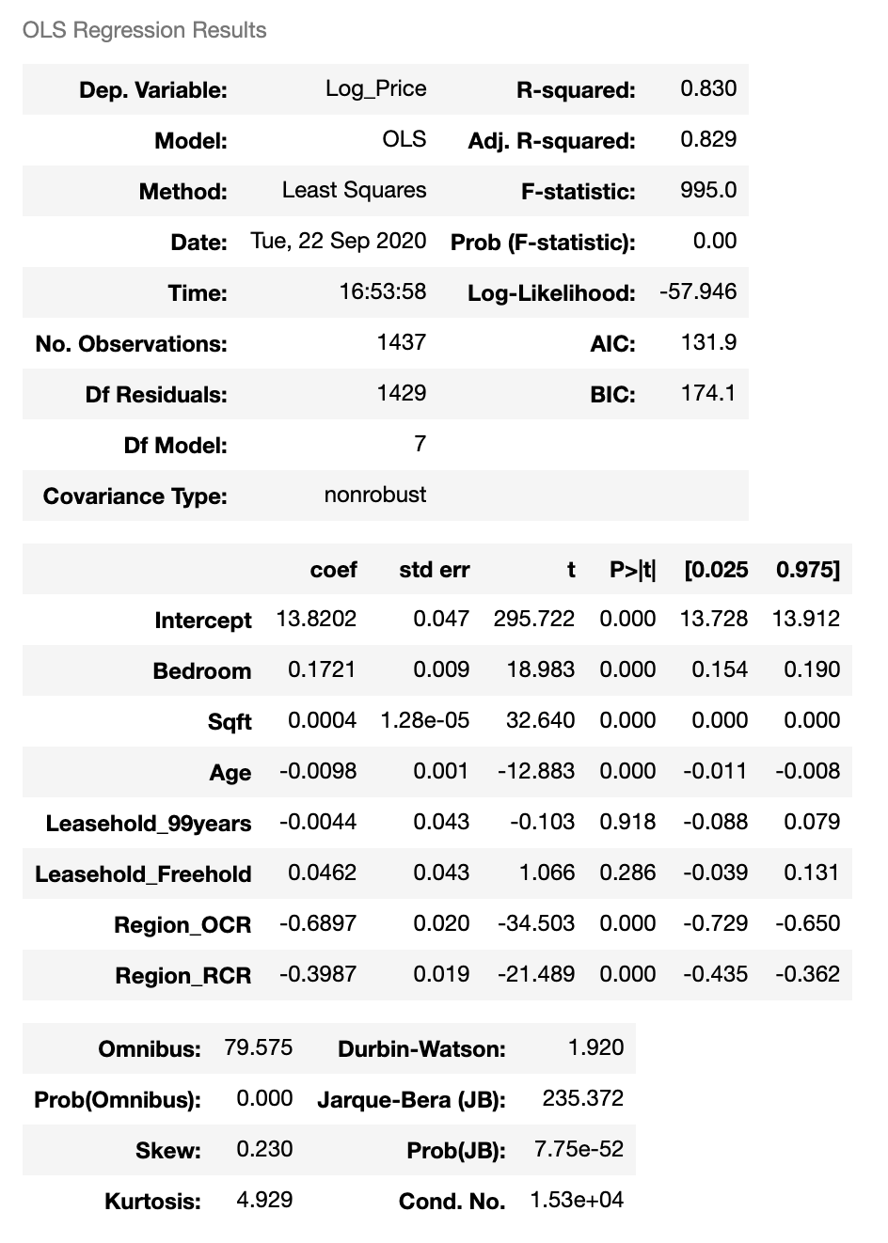
Linear Regression: Statsmodels
Prices are heavily influenced by the region where the condo is located
Number of Bedrooms and Bathrooms are the next features that have a stronger impact on condo prices
Interestingly ‘Age’ does not seem to have a high coefficient as many would have thought.

Slide 11
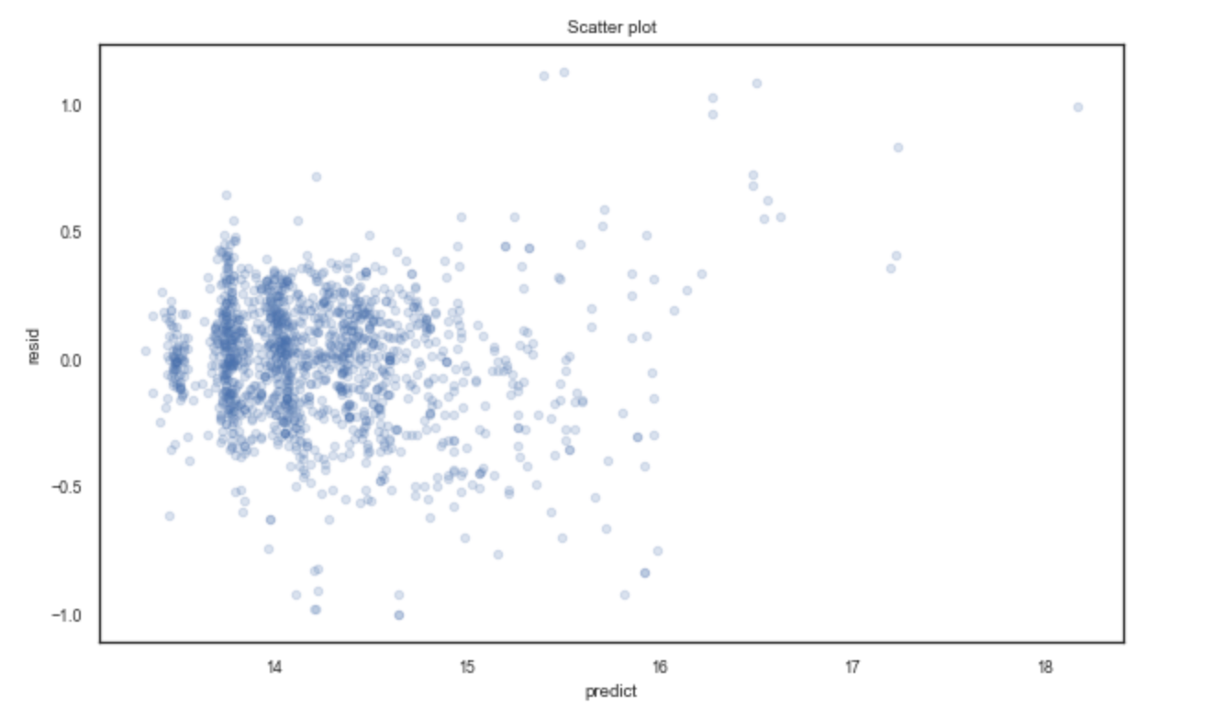
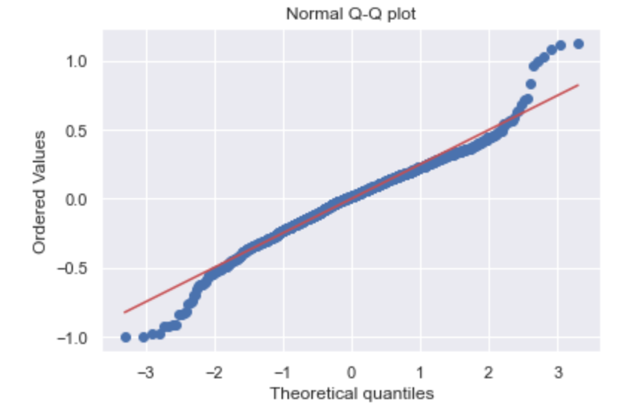
Statsmodel Outcome
Scatterplot suggests residuals are random but Q-Q plot shows that residuals do not really have a normal distribution.

Slide 12
Scikit Learn: Simple Validation Model
Determine the best model to use for regression
60% for training, 20% for validation, 20% for testing
Simple Validation suggest Polynomial Regression is the best model to be used
Regression Method | R²
Linear Regression | 0.823
Ridge Regression (alpha = 1) | 0.823
Polynomial Regression (degree = 2) | 0.882

Slide 13
Scikit Learn: Polynomial Regression VS Lasso CV
Compare the results against Lasso CV since Lasso Regression is often used for datasets with less features
Minimum alpha for Lasso Regression was found to be = 0.01
Regression Method | R²
Polynomial Regression (degree = 2) | 0.882
Lasso Regression (alpha = 0.01) | 0.825

Slide 14
Choice of Model: Polynomial Regression (Degree = 2)
Retrain the whole model based on the whole dataset and use it on the test data to get the outcomes
Regression Method | R2 | Adjusted R2 | Mean Absolute Error (MAE)
Polynomial Regression (Degree = 2) | 0.868 | 0.849 | 0.173

Slide 15
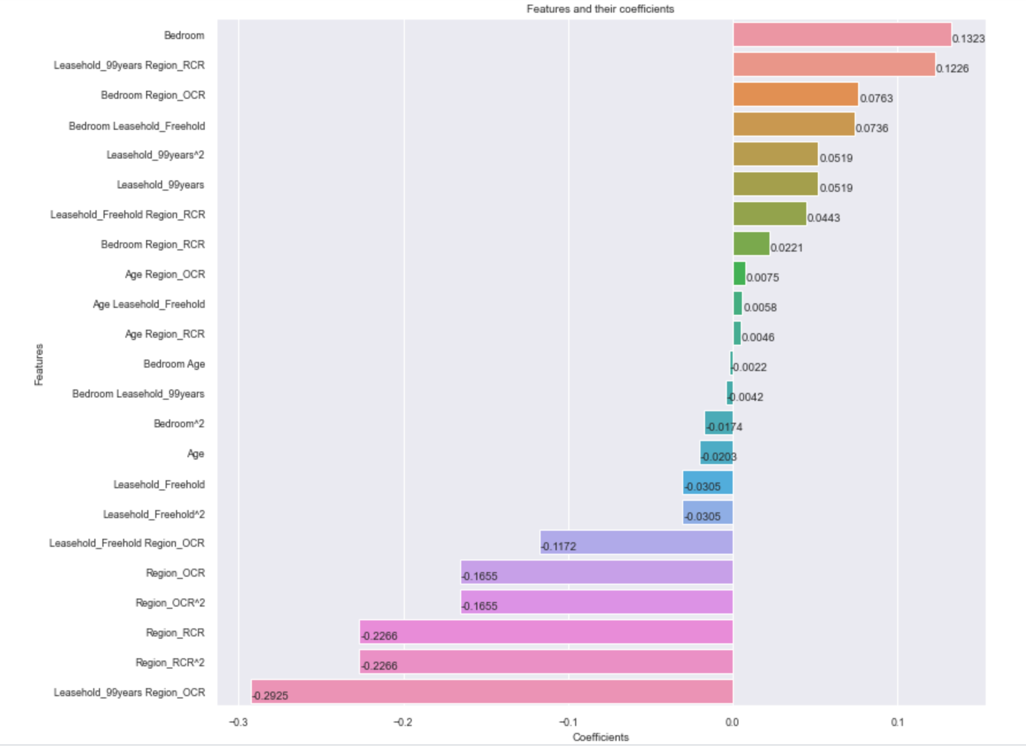
Polynomial Regression: Features and Coefficients
Findings suggest that both condos of 99 years lease and freehold lease in RCR are priced higher than condos of 999 years lease in CCR!
99 years leasehold condos are much cheaper than freehold condos in OCR region.
Possible bargains for condos in the CCR region.

Slide 16
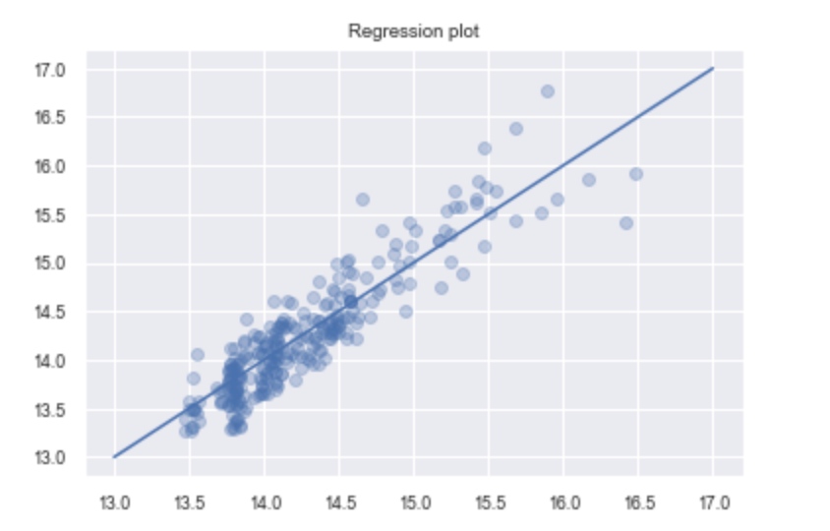
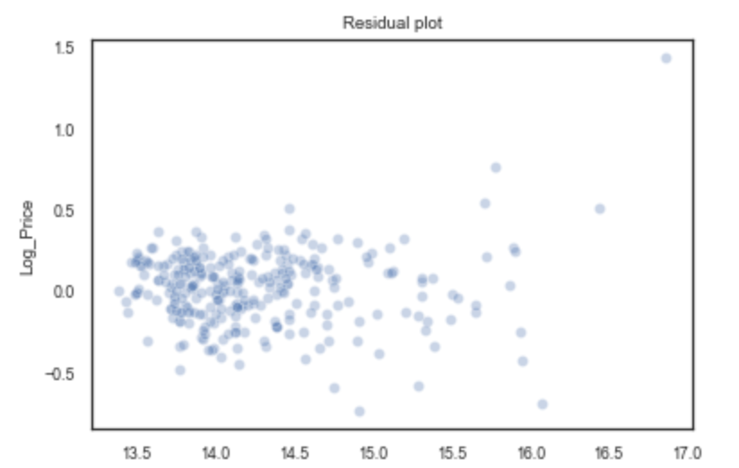
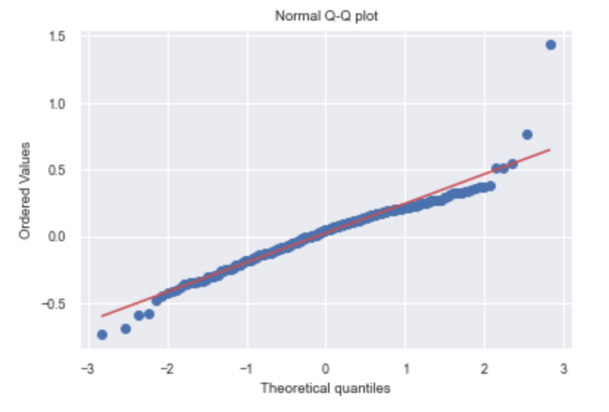
Regression Outcome

Slide 17
Key Takeaways: Recommendation from Polynomial Regression Model
Model | Key Recommendations
 | Buyers | Investors / Developers
Polynomial Regression | Consider a 99 years leasehold as compared to freehold condo in the OCR region if budget is a concern. Consider getting freehold condos in the CCR region if there is cash to splash. | Developers can consider building more condos with 99 years leasehold or freehold in the RCR region since current data shows the condo prices are much higher than those in CCR region.

Slide 18



For further discussion
If you would like to reach out for discussion on the analytics or the model, you can reach me via the following.
danielchang231285@gmail.com
https://www.linkedin.com/in/danielchang231285/
https://www.facebook.com/zoneticdan/
THANK YOU!

